Slide 1
Atliq Hardware Business Insights using SQL
Shaniba Firdouse

Slide 2
Introduction​
AtliQ Hardwares is a leading computerhardware manufacturer in India, with a strongand growing presence in multiple internationalmarkets.
The company specializes in producing high-quality hardware products and has been expanding rapidly across the APAC region.

Slide 3
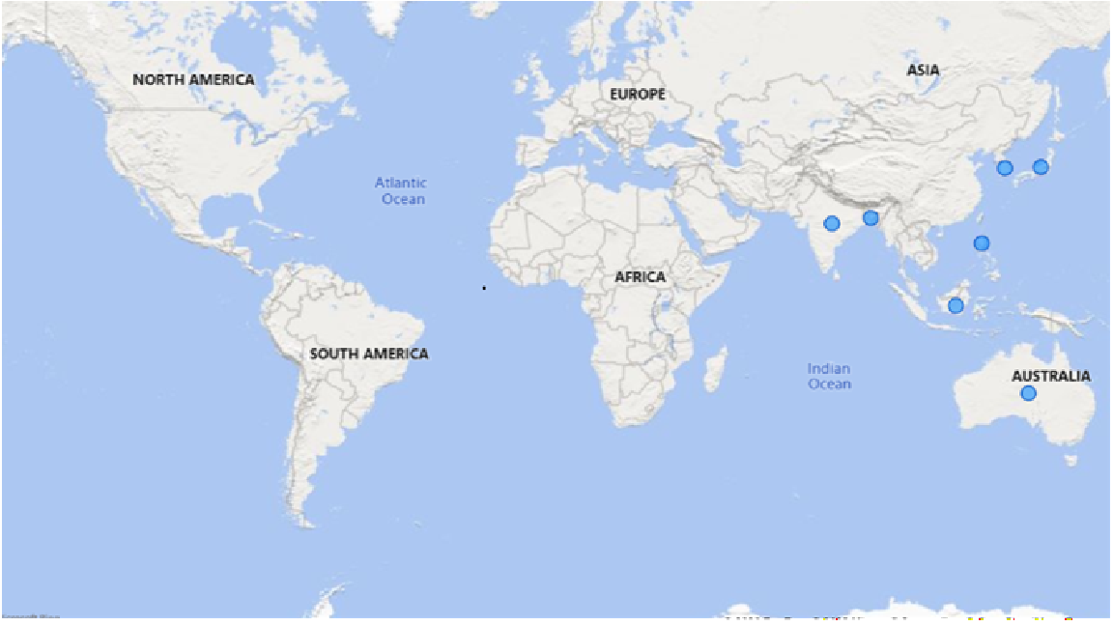
Provide the list of markets in which customer "Atliq Exclusive" operates its business in the APAC region.
India is one of the leading market in terms of Gross Sales for Atliq Exclusive in Asia Pacific region out of 8 countries, followed by South Korea, Indonesia, Australia and others.

Slide 4
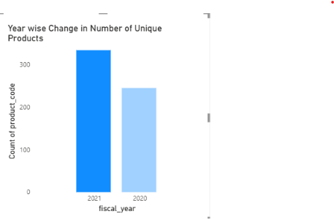
What is the percentage of unique product increase in 2021 vs. 2020? The final output contains these fields:
unique_products_2020
unique_products_2021
percentage_chg
We observe a 33.6% rise in number of unique products from 2020 to 2021.

Slide 5
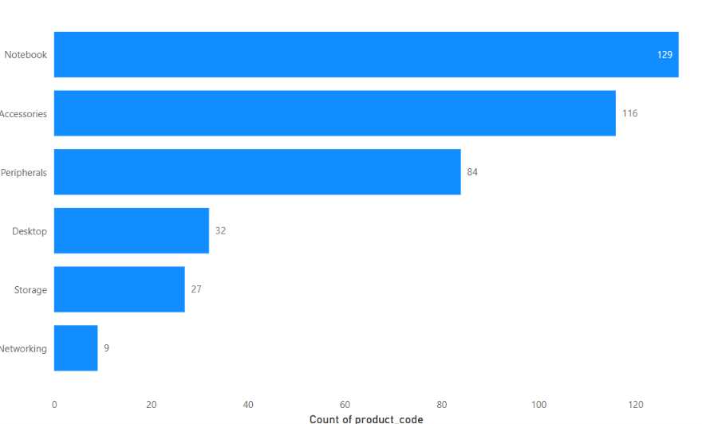
Provide a report with all the unique product counts for each segment and sort them in descending order of product counts.
Notebook segment has 129 unique products (Highest) and networking segment has 9 (Lowest) unique products

Slide 6
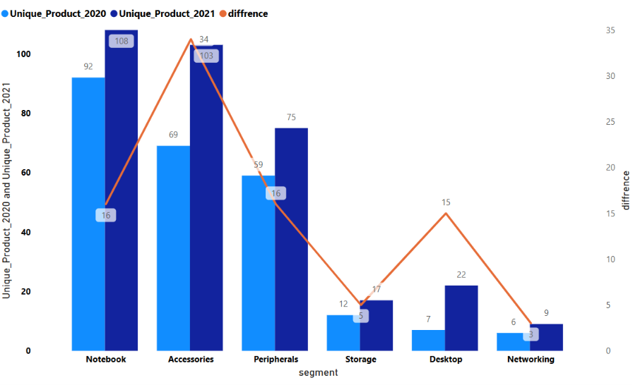
Follow-up: Which segment had the most increase in unique products in
2021 vs 2020?
The Accessories segment experienced the highest increase in unique products from 2020 to 2021, highlighting it as the company's fastest-growing product category.

Slide 7
Get the products that have the highest and lowest manufacturing costs.
AQ HOME Allin1 Gen 2 product has high manufacturing cost
AQ Master wired x1 Ms product has low manufacturing cost

Slide 8
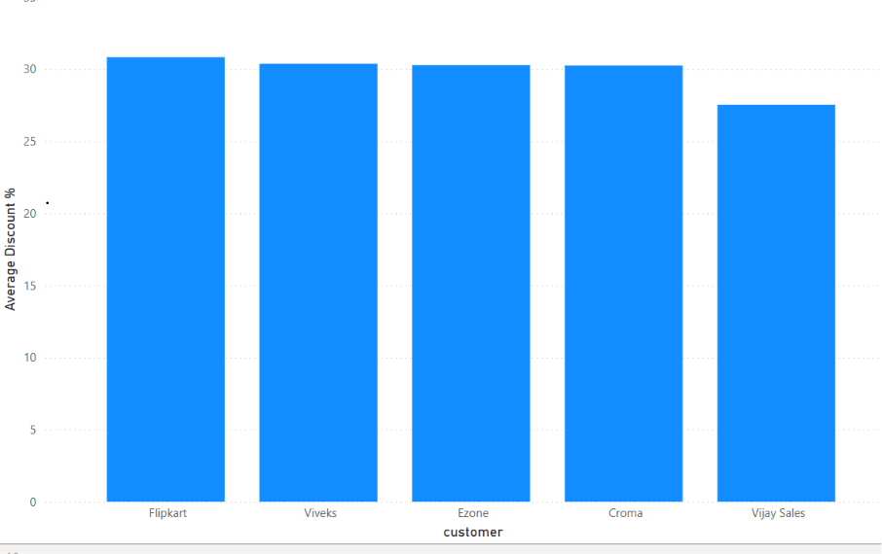
Generate a report which contains the top 5 customers who received an
average high pre_invoice_discount_pct for the fiscal year 2021 and in the
Indian market.
Flipkart received the highest average pre-invoice discount in the Indian market during FY 2021, which may be driven by its large sales volume and strategic importance.

Slide 9
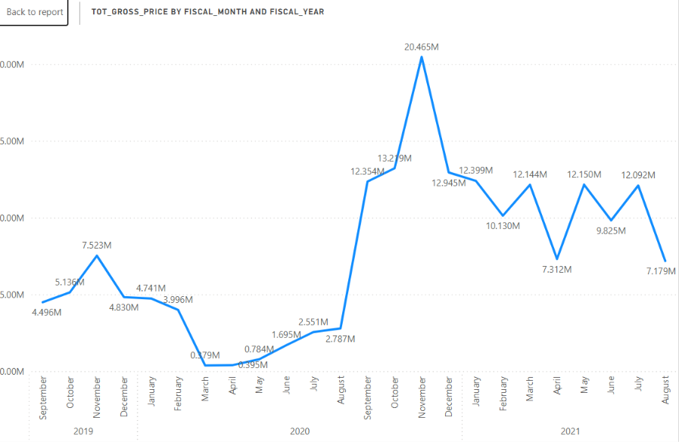
Get the complete report of the Gross sales amount for the customer “Atliq
Exclusive” for each month . This analysis helps to get an idea of low and
high-performing months and take strategic decisions.
Gross sales experienced a significant decline during the COVID-19 outbreak (March–May 2020) but recovered rapidly from June 2020.
Sales remained consistently strong throughout FY 2021, exceeding pre-pandemic levels.
November 2020 was the best-performing month, while relatively lower sales in April and August indicate opportunities for seasonal promotions and product launches to drive year-round revenue growth.

Slide 10
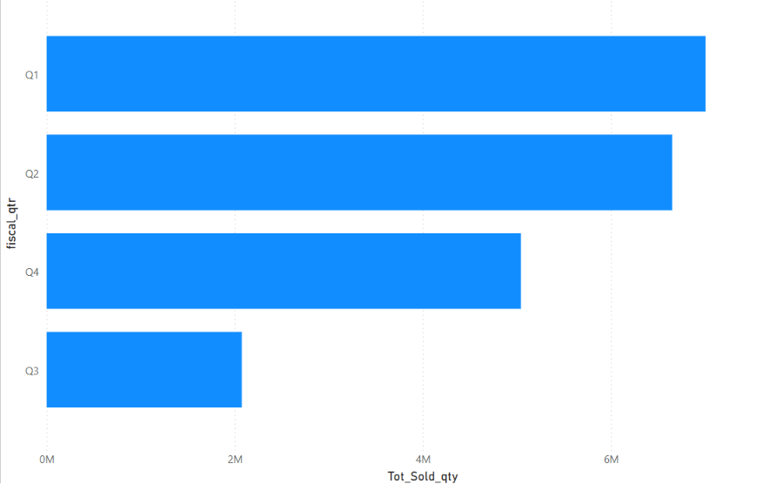
In which quarter of 2020, got the maximum total_sold_quantity?
Q1 2020 achieved the highest sales volume, highlighting the strongest demand period of the year.

Slide 11
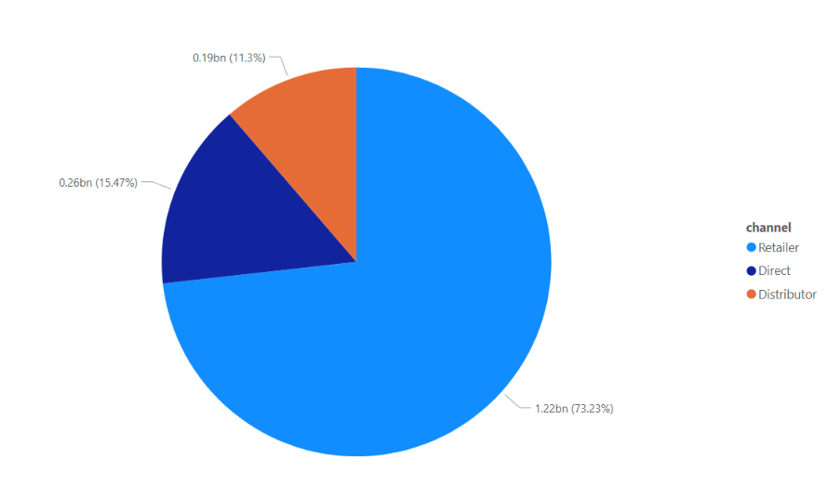
Which channel helped to bring more gross sales in the fiscal year 2021
and the percentage of contribution?
Retailer emerged as the leading sales channel in FY 2021, contributing the highest share of gross sales.
This highlights the importance of retail partnerships in driving revenue growth.
Strengthening this channel while improving other channel performances can help maximize overall sales.

Slide 12
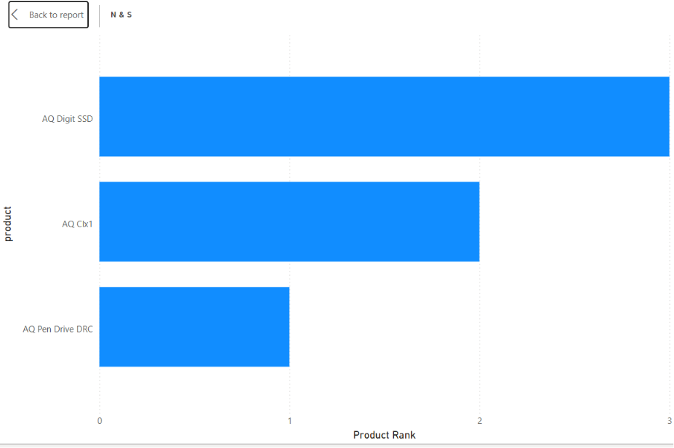
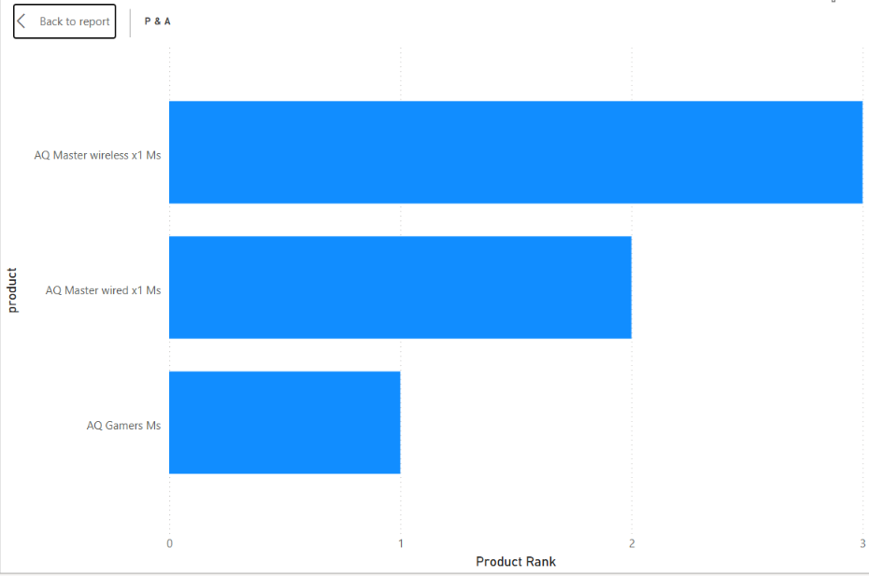
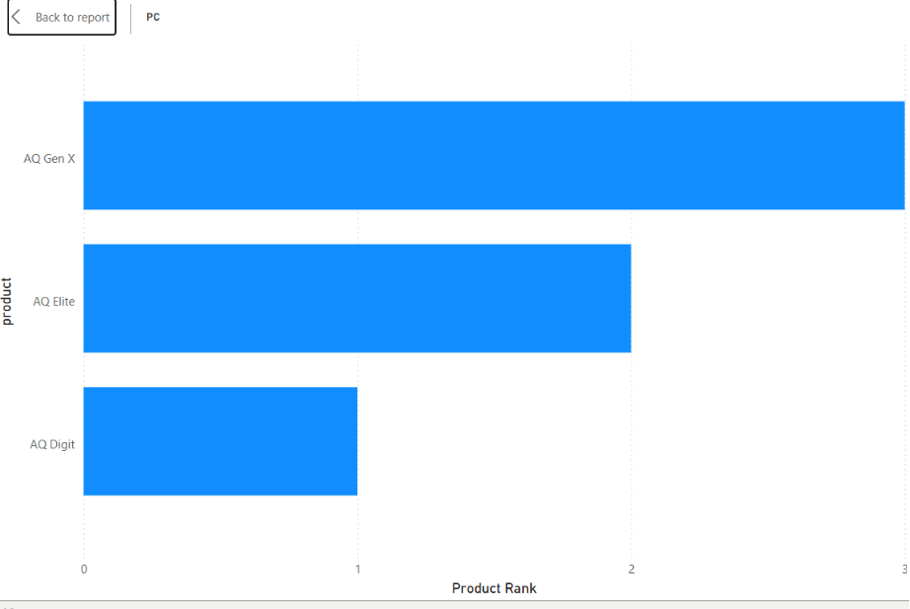
Top 3 products in each division that have a high
total_sold_quantity in the fiscal_year 2021
N & S division recorded the highest product sales volumes, with AQ Pen Drive 2 IN 1 leading at 701,373 units sold, indicating strong customer demand for storage accessories.
P & A division also demonstrated strong performance, with the top three products each selling over 419,000 units, reflecting consistent demand across its best-selling products.
PC division had significantly lower sales volumes, with its top-selling product (AQ Digit) selling only 17,434 units, suggesting lower demand or a more specialized market compared to the other divisions.

Slide 13
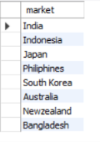

QUERIES
1. Provide the list of markets in which customer "Atliq Exclusive" operates its business in the APAC region.

Slide 14
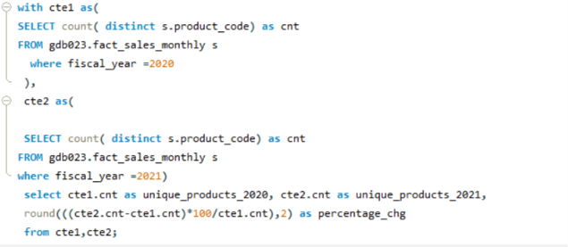

QUERIES
2. What is the percentage of unique product increase in 2021 vs. 2020? The
final output contains these fields,
unique_products_2020
unique_products_2021
percentage_chg

Slide 15
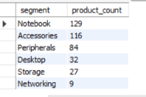
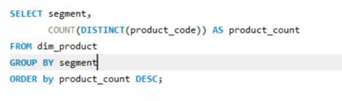
QUERIES
3. Provide a report with all the unique product counts for each segment and
sort them in descending order of product counts. The final output contains
2 fields,
segment
product_count

Slide 16
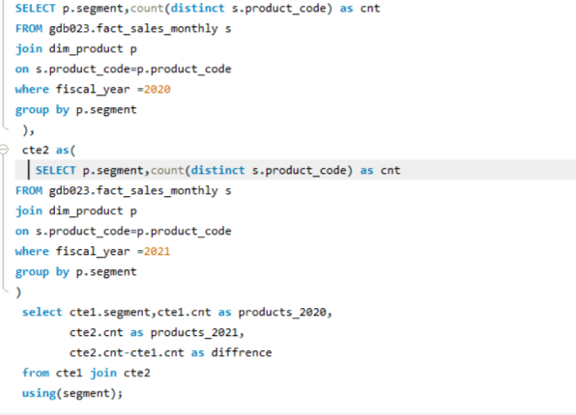
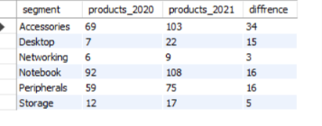
QUERIES
4. Follow-up: Which segment had the most increase in unique products in 2021 vs 2020? The final output contains these fields,
segment
product_count_2020
product_count_2021
difference

Slide 17
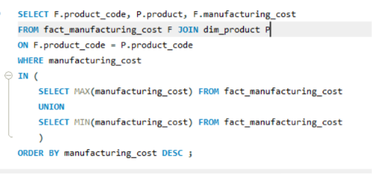

QUERIES
5. Get the products that have the highest and lowest manufacturing costs.
The final output should contain these fields,
product_code
product
manufacturing_cost

Slide 18
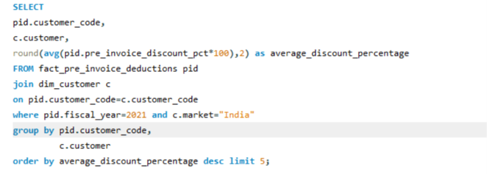
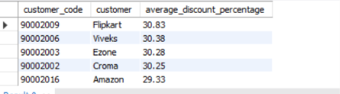
QUERIES
6. Generate a report which contains the top 5 customers who received an
average high pre_invoice_discount_pct for the fiscal year 2021 and in the
Indian market. The final output contains these fields,
customer_code
customer
average_discount_percentage

Slide 19
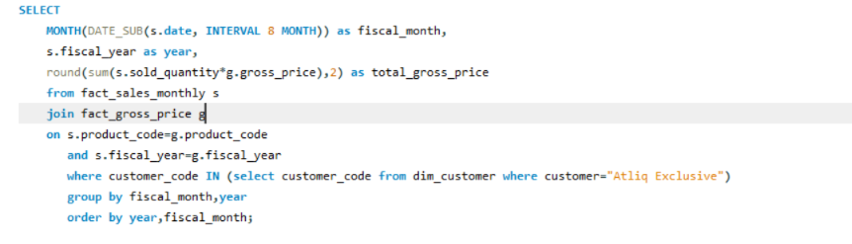
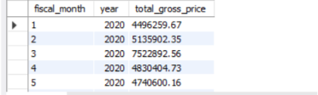
QUERIES
7. Get the complete report of the Gross sales amount for the customer “Atliq
Exclusive” for each month . This analysis helps to get an idea of low and
high-performing months and take strategic decisions.
The final report contains these columns:
Month
Year
Gross sales Amount

Slide 20
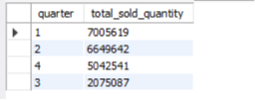
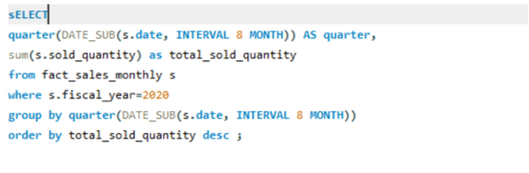
QUERIES
8. In which quarter of 2020, got the maximum total_sold_quantity? The final
output contains these fields sorted by the total_sold_quantity,
Quarter
total_sold_quantity

Slide 21
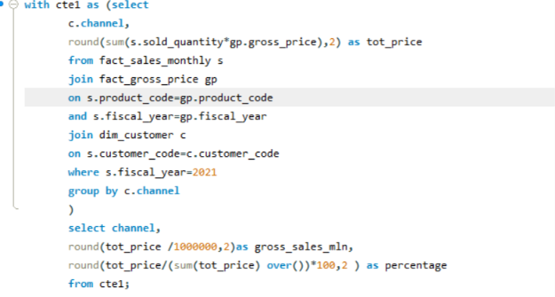

QUERIES
9. Which channel helped to bring more gross sales in the fiscal year 2021
and the percentage of contribution? The final output contains these fields,
channel
gross_sales_mln
percentage

Slide 22
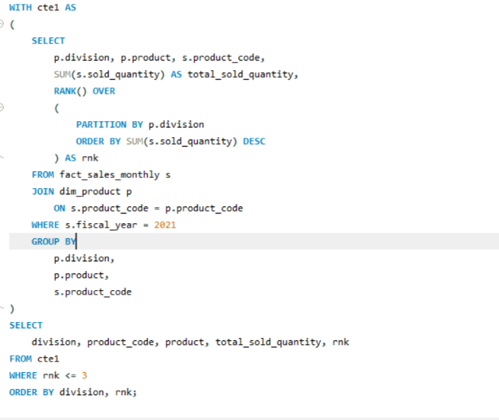
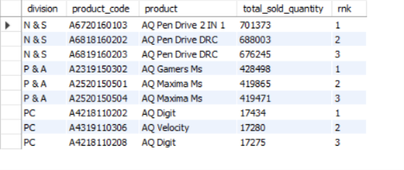
QUERIES
10.Get the Top 3 products in each division that have a high
total_sold_quantity in the fiscal_year 2021? The final output contains these
fields,
division
product_code,
product
total_sold_quantity
rank_order

